Slide 1

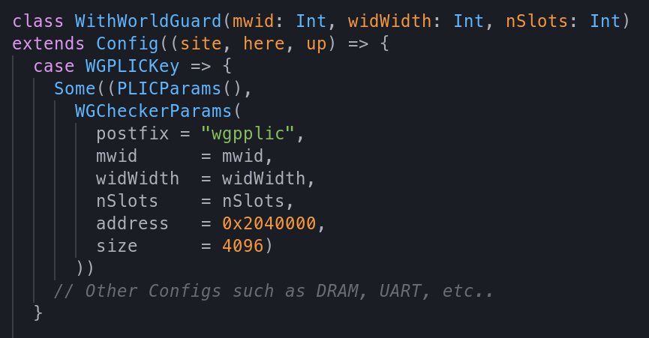
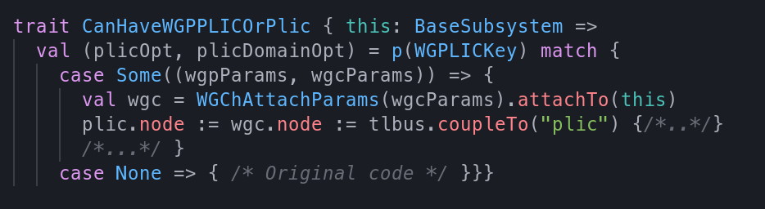


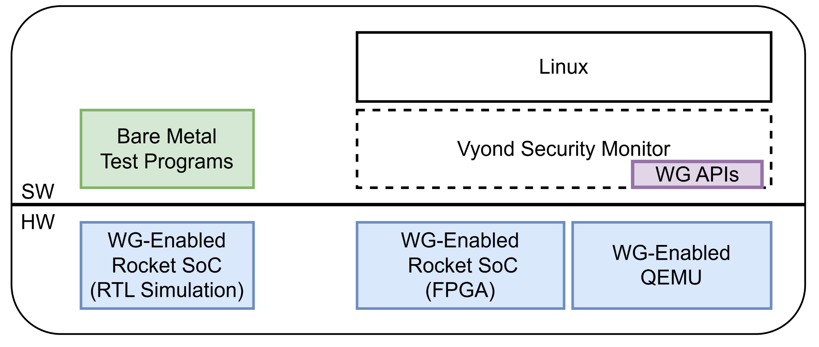
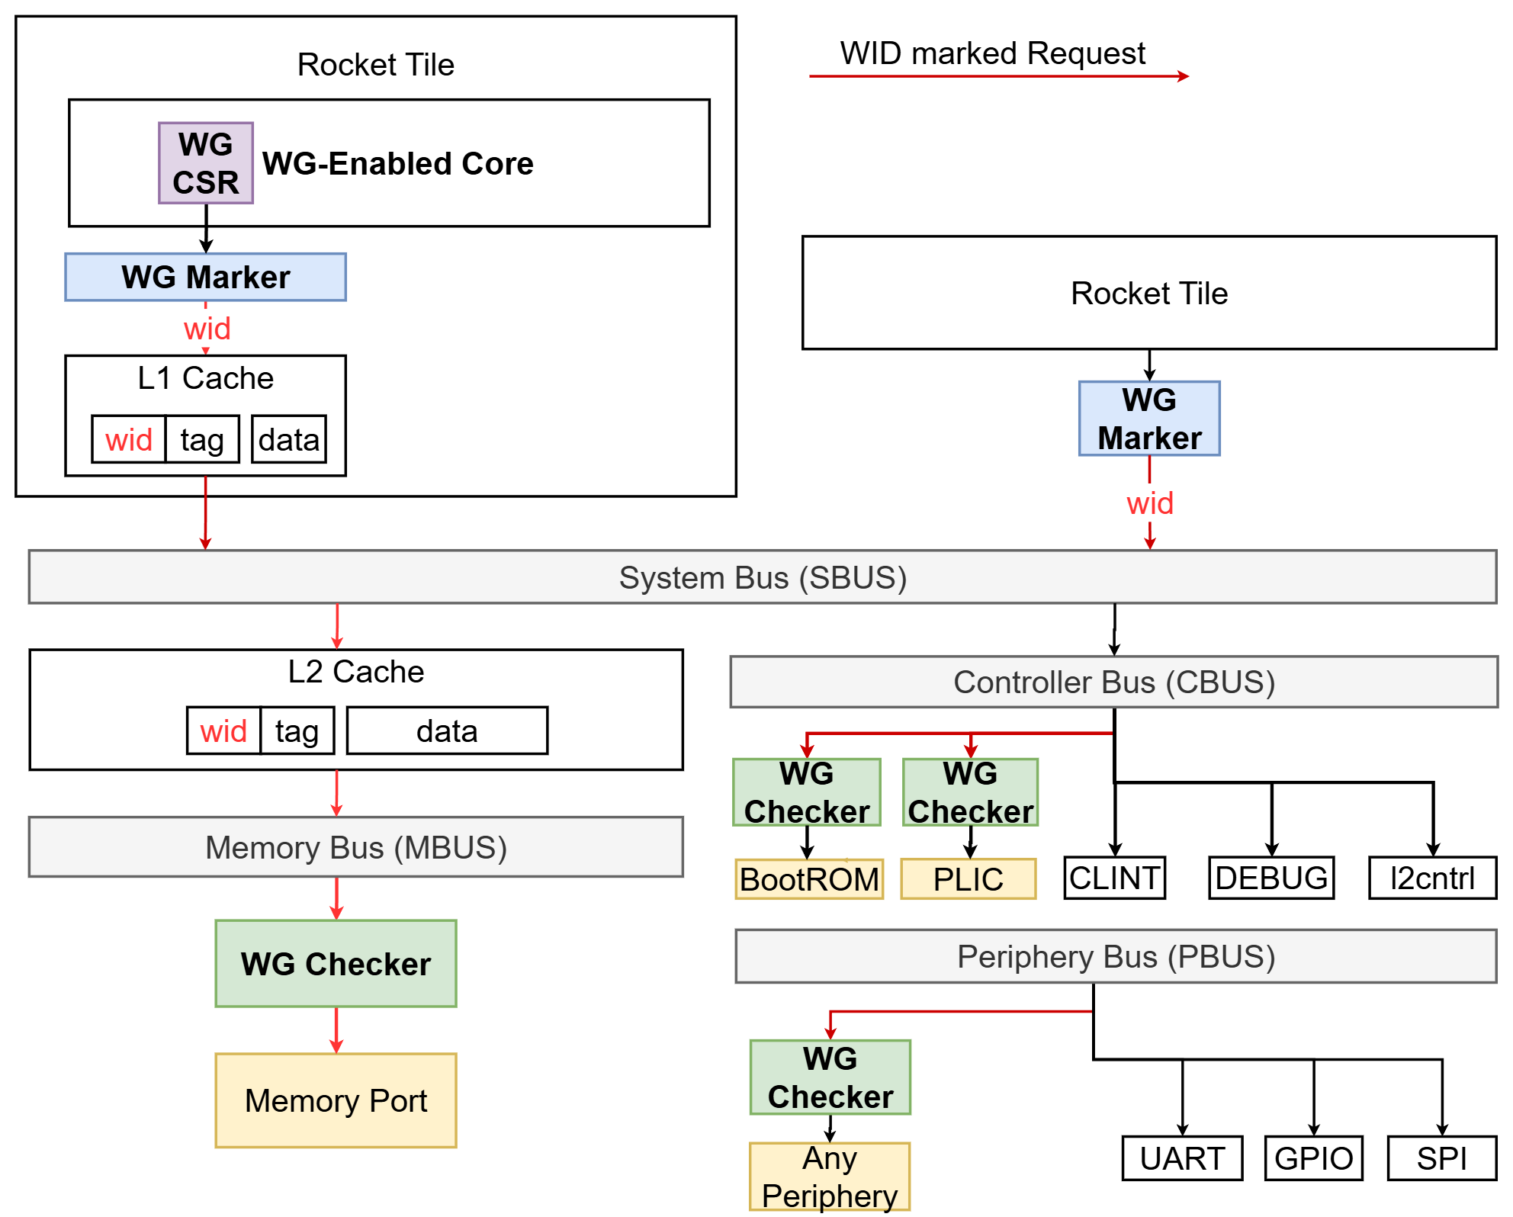

Vyond
Vyond: Flexible and Rapid WorldGuard-Based
Security Prototyping using Chipyard
Sungkeun Kim
Samsung Research
Hardware Isolation Primitives
for Trusted Execution Environments (TEEs)
Key Features of Vyond
1. Prevent Unauthorized Access
Ensures that sensitive code and data are isolated from untrusted SW, including OS and hypervisor
2. Minimize Trusted Computing Base (TCB)
HW primitives enable smaller and more verifiable TCBs by enforcing boundaries at the HW level
3. Enforce Strong Access Control
HW isolation provides robust access control mechanisms that SW alone cannot guarantee
1. Generators for WorldGuard Marker and Checker
- Easy to configure and place markers and checkers
2. Support for different security design phase - Simulation, FPGA, and QEMU
- Security designer can use a proper setup depending on their design phase
3. Example configurations and test programs
- They can be references of a security monitor
- One example found a potential issue on WorldGuard specification (reported to Security TG)
4. Reference Security Monitor
- A security monitor that protects enclaves using WorldGuard (WG)
U-mode
App1
App2
Untrusted
OS
S-mode
Malicious Code
SW
M-mode
Security Monitor
HW
HW
Resource
Isolation IP
WorldGuard Checker Configuration for PLIC
DRAM
App1
App2
WorldGuard Checker Placement between PLIC and Bus
Configurable Hardware Isolation for Fast Prototyping
Not configurable
No WorldGuard Implemented
Vyond
Enables Rapid Prototyping
Configurable WorldGuard Implemented
Use Cases and Future Potential
Security Prototyping with WorldGuard on Chipyard
Collaboration of PMP and WorldGuard for complete isolation
- To Protect statically allocated regions (SM, I/O devices) → WorldGuard
No extra works is required for enclave migration (e.g., PMP register update)
Useful in Robot, Car, and IoT devices with many sensors
- To protect dynamically allocated regions (OS, Enclaves) → PMP
As PMP is per-core solution, it is easy for SM to reallocate memory region for different enclave.
1. Implemented WorldGuard Specification (v4.0)
- Implemented WorldGuard Checkers (WGC) and Markers (WGM)
- Extended Rocket Core (CSRs, TLB, and Caches), Inclusive Cache (LLC)
2. WorldGuard as Chipyard generator
- Minimum changes in Chipyard to be part of Chipyard
Hart
PMP-isolated regions
App
App
App
World 1
World 2
WG-isolated regions
OS
Enclave 1
Enclave 2
World 3
World 1
World 2
Security Monitor (SM)
IO Device
IO Device
PMP
wgMarker
wgMarker
wgChecker
BUS
wgChecker
OS
World 3
Enclave 1
Enclave 2
World 1
World 2
References :
1. https://lists.riscv.org/g/security/attachment/711/0/worldguard_rvia_spec-v0.4.pdf
2. https://github.com/ucb-bar/chipyard
3. https://patchwork.ozlabs.org/project/qemu-devel/cover/20240612081416.29704-1-jim.shu@sifive.com
DRAM
Contact :
https://www.github.com/Samsung/vyond
sk84.kim@samsung.com

